Slide 1
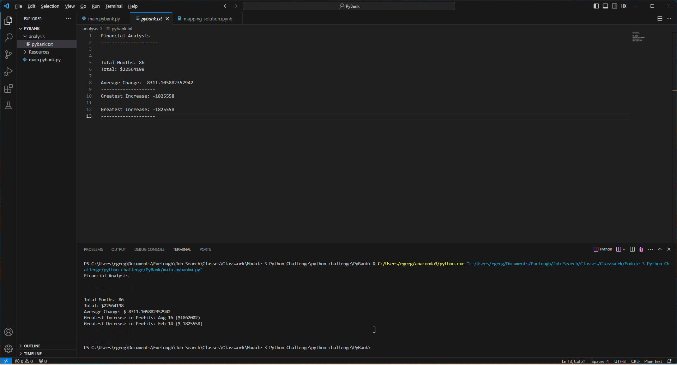
PyBank.py – Text and Terminal Outputs

Slide 2
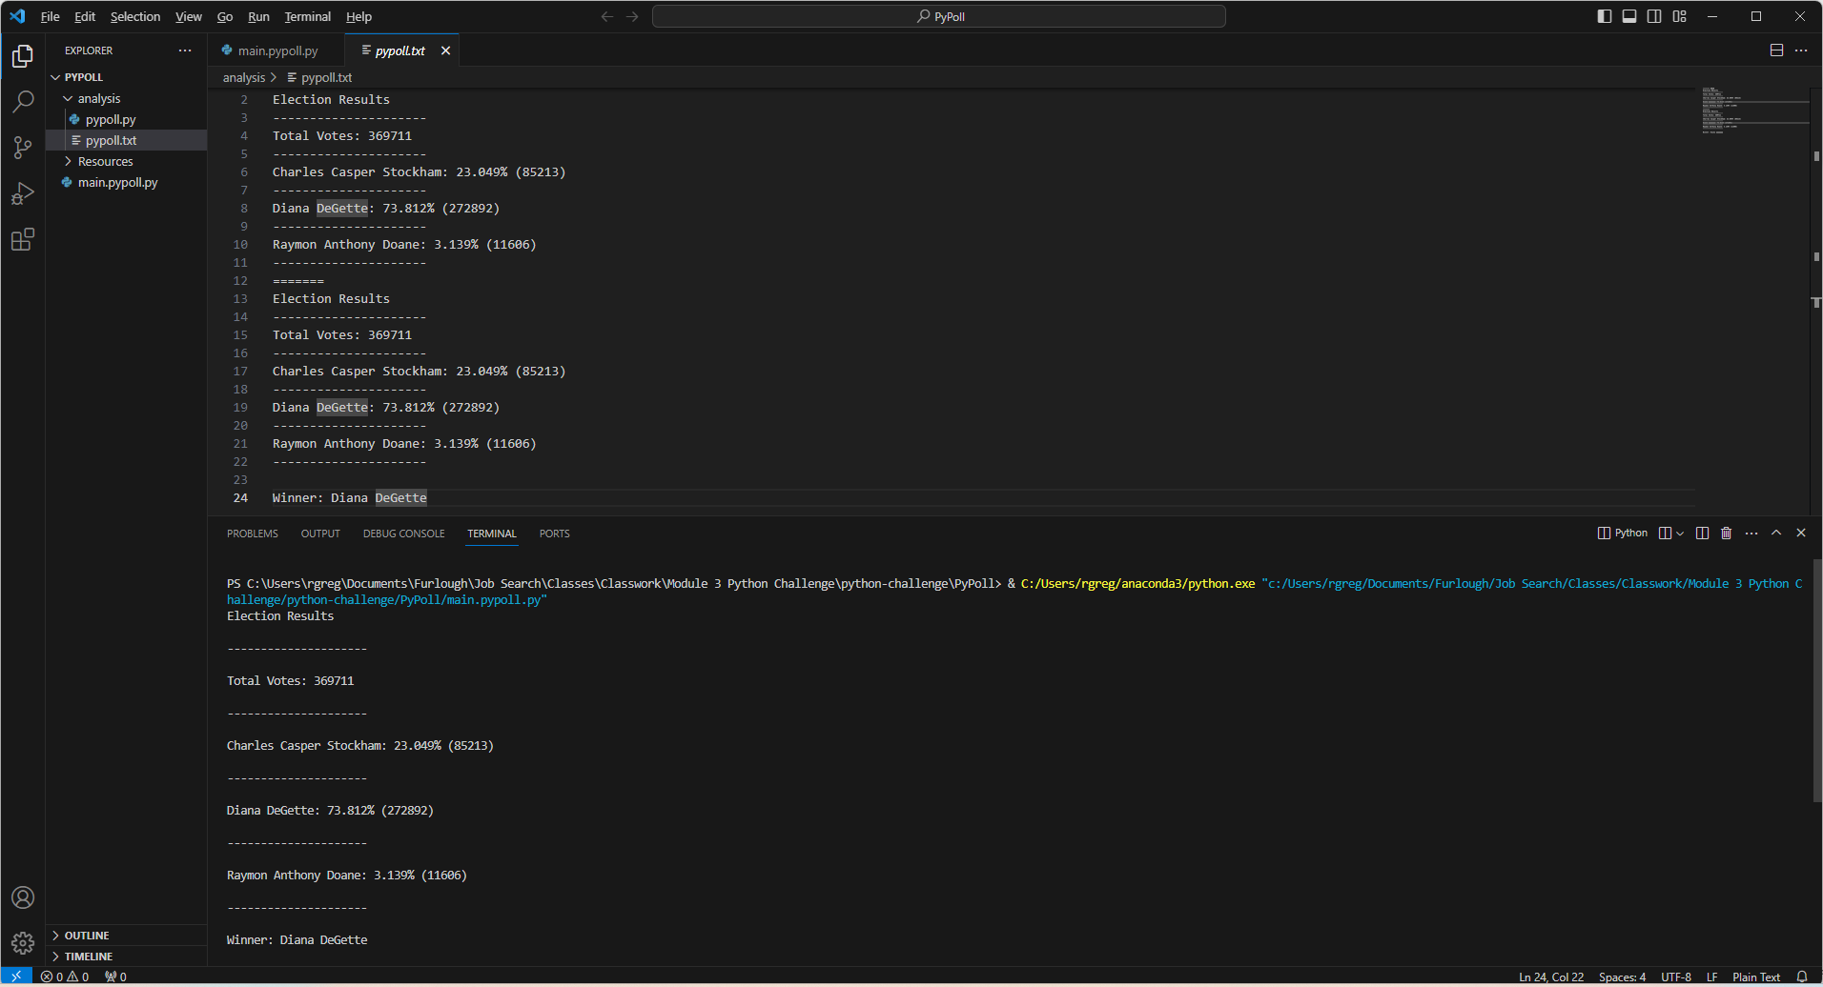
PyPoll.py – Text and Terminal Outputs

